Slide 1
Computational thinking
Mack 2023
Notes:
Last updated: 6/13/2023

Slide 2
Warm Up

Slide 3

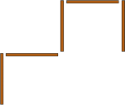
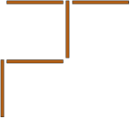
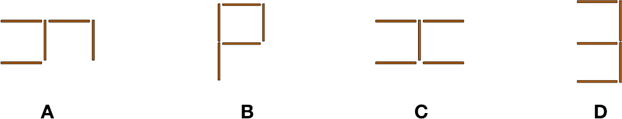
Five sticks
Starter activity
Adam has five sticks. He puts them on the table and creates this shape:
Nola comes to the table. She takes one stick and puts it in a different place:
Then Bob comes to the table, he also takes one stick and puts it in a different place. Question: Which shape is Bob not able to make?
Think, write, pair, share
A
B
C
D
Notes:
Source: UK Bebras computational thinking challenge 2017 http://www.bebras.uk/answer-booklets.html

Slide 4
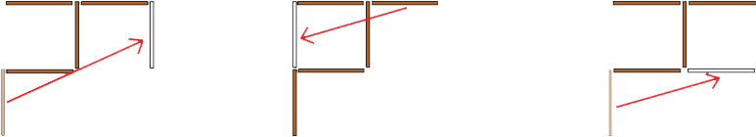
Five sticks
Starter activity
Answer: The answer is D. Explanation:
Needs more than one stick to be moved.
A
B
C
D
Notes:
Source: UK Bebras computational thinking challenge 2017 http://www.bebras.uk/answer-booklets.html

Slide 5

Lesson 22: Computational thinking
Objectives
In this lesson, you will:
Define the terms decomposition, abstraction, and algorithmic thinking
Recognise scenarios where each of these computational thinking techniques are applied
Apply decomposition, abstraction, and algorithmic thinking to help solve a problem

Slide 6
Activity 1

Slide 7
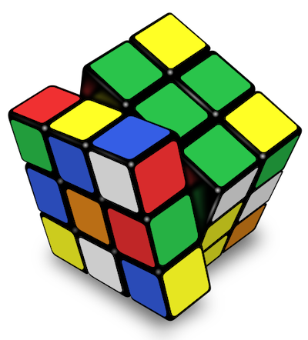
What is computational thinking?
Activity 1
Computational thinking is a systematic approach to solving problems.
This involves understanding a problem and developing possible solutions that can be understood by a computer, person, or both.
Notes:
Image source: https://en.wikipedia.org/wiki/File:Rubik%27s_cube_v3.svg

Slide 8
What is computational thinking?
Activity 1
There are three characteristics of computational thinking that you need to be aware of:
Decomposition
Abstraction
Algorithmic thinking

Slide 9
Activity 2

Slide 10

What is decomposition?
Activity 2
Decomposition is the process of breaking problems down into smaller, more manageable parts.
Each of these sub-problems can then be looked into and solved separately, which makes it easier to solve the overall problem. If the sub-problems are not “manageable” enough, they could be further decomposed.
Problem
Sub-problem
Sub-problem
Sub-problem

Slide 11

What is decomposition?
Activity 2
To understand how decomposition can be applied, let’s look at an example of a problem to solve.
Imagine you are organising a trip to the Eiffel tower in Paris.
What things would you need to plan in order to get from your home town to the Eiffel tower?
Notes:
Image source: https://pixabay.com/photos/eiffel-tower-france-paris-landscape-975004/

Slide 12
What is decomposition?
Activity 2
You can start breaking down the problem into smaller parts:
Which mode of transport are you using to get from the UK to Paris?
How are you getting from Paris to the Eiffel tower?
What tickets do you need to book for your journey?
Notes:
Image source: https://pixabay.com/photos/eiffel-tower-france-paris-landscape-975004/

Slide 13
What is decomposition?
Activity 2
A structure diagram can be used to visualise a problem by showing the different levels of detail.
This overview illustrates how each sub-problem relates to other parts of the structure.
Trip to Eiffel Tower
Transport
Tickets
UK to Paris
To Eiffel Tower

Slide 14
Activity 3

Slide 15
What is abstraction?
Activity 3
Abstraction is the process of removing unnecessary information and focussing on the important details.
This allows you to develop a general idea of what the problem is and how to solve it.

Slide 16
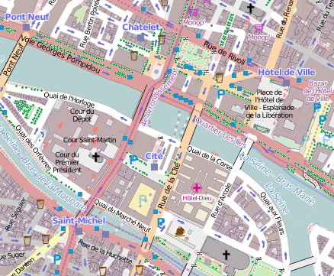
What is abstraction?
Activity 3
A great example of abstraction is the use of maps. A map includes only the information that is relevant.
The Paris street map in this example contains the roads, river, and names of important landmarks.
It doesn’t include the exact details of how the buildings look in real life.
Notes:
Image source: https://commons.wikimedia.org/wiki/File:1er_Arrondissement,_Paris,_France_-_Open_Street_Map.png

Slide 17
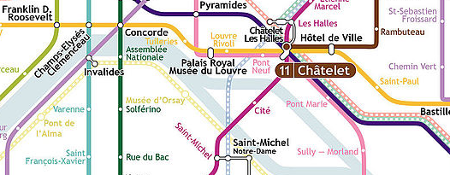
What is abstraction?
Activity 3
There are also different levels of abstraction that serve different purposes.
The Paris Metro map has even more detail removed from it, only showing the lines, stops and river.
In which case would you use each map and why?
Notes:
Image source: https://commons.wikimedia.org/wiki/File:1er_Arrondissement,_Paris,_France_-_Open_Street_Map.png
Image source: https://en.wikipedia.org/wiki/Paris_M%C3%A9tro#/media/File:Carte_M%C3%A9tro_de_Paris.jpg

Slide 18
Activity 4

Slide 19
What is algorithmic thinking?
Activity 4
❠
Algorithmic thinking is the process of developing an algorithm to solve a problem.
An algorithm is a precise step-by-step solution to a problem that can be replicated by a human, computer, or both.
“Algorithmic thinking is not solving for a specific answer; instead, it solves how to build a sequential, complete, and replicable process that has an end point – an algorithm”.
Anna McVeigh-Murphy
The One About Algorithmic Thinking in Computational Thinking [link]

Slide 20
What is algorithmic thinking?
Activity 4
For example, an algorithm for getting the Eurostar to Paris could be:
Go to platform 5 at London St Pancras for 07:45 AM.
Wait until the 08:15 AM Eurostar arrives on the platform, then board Carriage 5.
Find seat 57 and sit there.
Wait until arriving in Paris, then alight from the Eurostar.
Notes:
Image source: https://pixabay.com/photos/eiffel-tower-france-paris-landscape-975004/

Slide 21
Activity 5

Slide 22

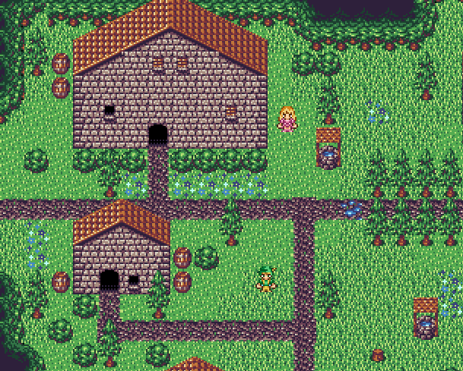
Planning a game
Activity 5
In this activity you are going to apply each computational thinking skill to help you plan a game.
The game involves moving a character around a simple world.
Answer the questions on the Activity 5 worksheet to guide your planning.
Notes:
Image source: https://opengameart.org/content/16x16-jrpg-tilesets-enlarged-2x

Slide 23
Activity 6

Slide 24

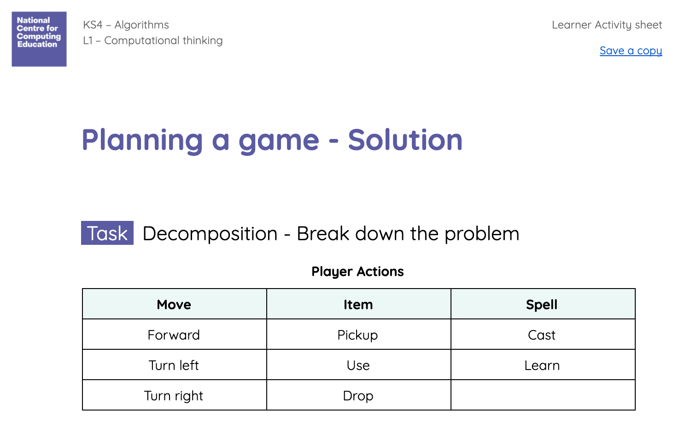
Peer review your game plans
Activity 6
Sit with a partner and peer review your game plans.
Use the worksheet solution to help you with this.

Slide 25
Activity 7

Slide 26
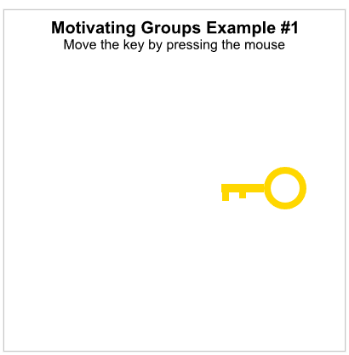
Intro to Groups
Activity 7
A group is a collection of shapes that we can treat as a single shape. To help see why groups are useful, let's start with this example that draws a key and moves it as you press the mouse:

Slide 27

Intro to Groups
Activity 7
Complete 3pts worth of exercises!

Slide 28
Wrap Up

Slide 29
Revisiting five sticks
Wrap Up
How could the following techniques be applied to solving the five sticks problem?
Decomposition
Abstraction
Algorithmic thinking
Nola comes to the table. She takes one stick and puts it in a different place:
Then Bob comes to the table, he also takes one stick and puts it in a different place. Which shape is Bob not able to make?

Slide 30
Next lesson
Summary
In this lesson, you…
Defined the terms decomposition, abstraction and algorithmic thinking.
Recognised scenarios where each of these computational thinking techniques are applied.
Applied decomposition, abstraction and algorithmic thinking to help solve a problem.
Next lesson, you will…
Explore how algorithms can be represented in a number of ways, including as flowcharts.

